Slide 1
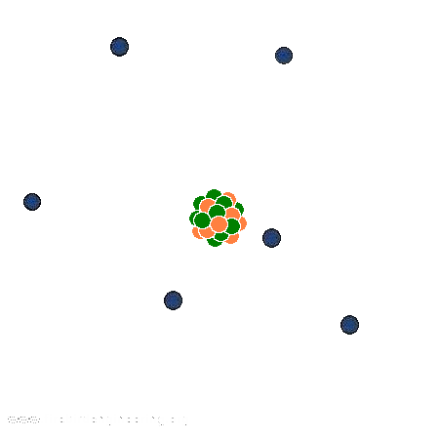
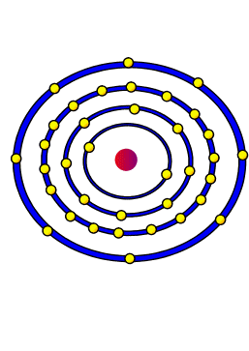
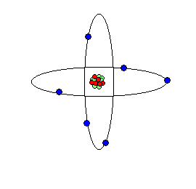
The Structure of the Atom
Chapter 4

Slide 2
The first people to think about particle theory were the Greeks around 400 BC. One in particular was Democritus. The word atom in Greek means indivisible. Following Democritus was Aristotle. He didn’t believe in atoms. He thought matter was continuous. This idea succeeded for about 2000 years. Neither view was supported by experimental evidence until 1700.
By the late 18th, most people thought of an atom as something that could not be broken down and that could combine with other elements to form compounds. Scientists still weren’t sure, however, if they always combined in the same proportions. In the 1790’s scientists had better balances which allowed them to study chemical reactions quantitatively. This led to the law of conservation of mass. It essentially says that as long as nothing enters or leaves a chemical reaction, mass remains constant. It also led to the law of Definite Proportions which essentially says that regardless of the source or size of sample of the sample, the elements that make it up are always there in the same ratio.
More complicated is the law of Multiple Proportions. It says that if 2or more different
compounds are made of the same 2 elements, the ratio of the second element combined with a
fixed mass of the 1st elements is always a ratio of small whole numbers. An example of this
would be the 2 compounds carbon monoxide and carbon dioxide.
These three laws prompted John Dalton to propose his atomic theory. It basically says:
All matter is made of small called atoms.
Atoms of the same element are chemically and physically the same.
Atoms of different elements are chemically and physically different.
When atoms combine in a chemical reaction, they do so in small, whole number ratios.
In a chemical reaction, atoms aren’t Created or destroyed, they are simply rearranged.

Slide 3
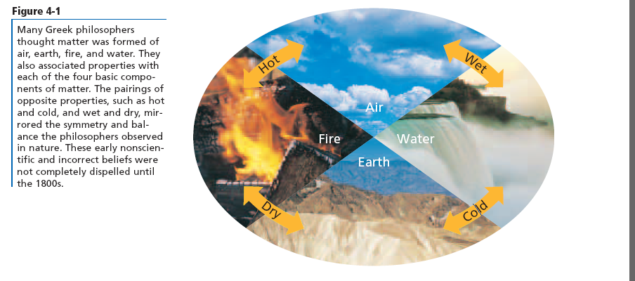
The first people to think about particle theory were the Greeks around 400 BC

Slide 4
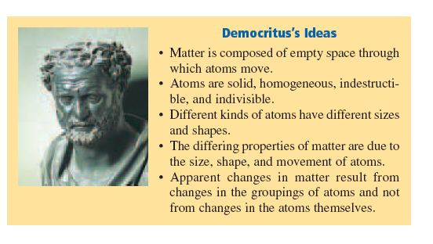
One in particular was Democritus.

Slide 5
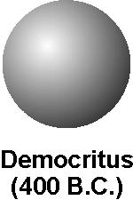

Slide 6
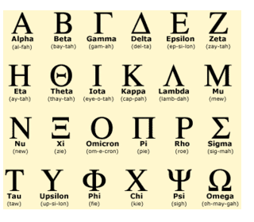
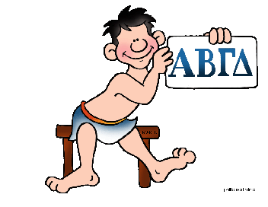
The word atom in Greek means indivisible.

Slide 7
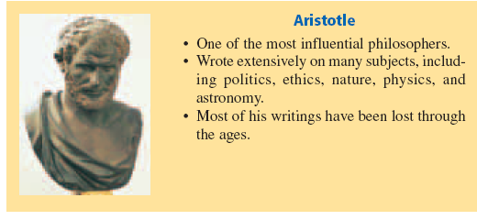
Following Democritus was Aristotle. He didn’t believe in atoms. He thought matter was continuous.

Slide 8
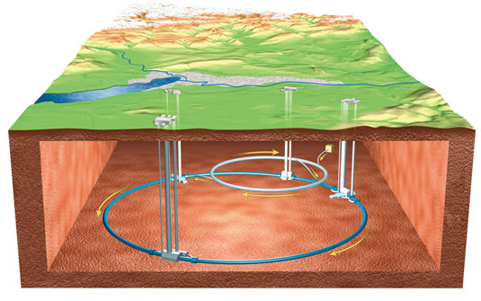
This idea succeeded for about 2000 years. Neither view was supported by experimental evidence until 1700..

Slide 9
By the late 18th , most people thought of an atom as something that could not be broken down and that could combine with other elements to form compounds.

Slide 10
Scientists still weren’t sure, however, if they always combined in the same proportions.

Slide 11
In the 1790’s scientists had better balances which allowed them to study chemical reactions quantitatively.

Slide 12
This led to the law of conservation of mass.
It essentially says that as long as nothing enters or leaves a chemical reaction, mass remains constant.

Slide 13
It also led to the law of Definite Proportions which essentially says that regardless of the source or size of sample; the elements that make it up are always there in the same ratio.

Slide 14
More complicated is the law of Multiple Proportions.It says that if 2 or more different
compounds are made of the same 2 elements, the ratio of the second element combined with a fixed mass of the 1st elements is always a ratio of small whole numbers.

Slide 15
An example of this would be the 2 compounds carbon monoxide and carbon dioxide.

Slide 16
These three laws prompted John Dalton to propose his atomic theory. It basically says:
All matter is made of small indivisible particles called atoms.
Atoms of the same element are chemically and physically the same.
Atoms of different elements are chemically and physically different.
When atoms combine in a chemical reaction, they do so in small, whole number ratios.
In a chemical reaction, atoms aren’t Created or destroyed, they are simply rearranged

Slide 17
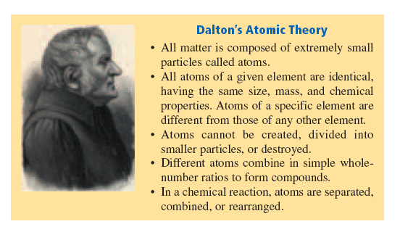

Slide 18
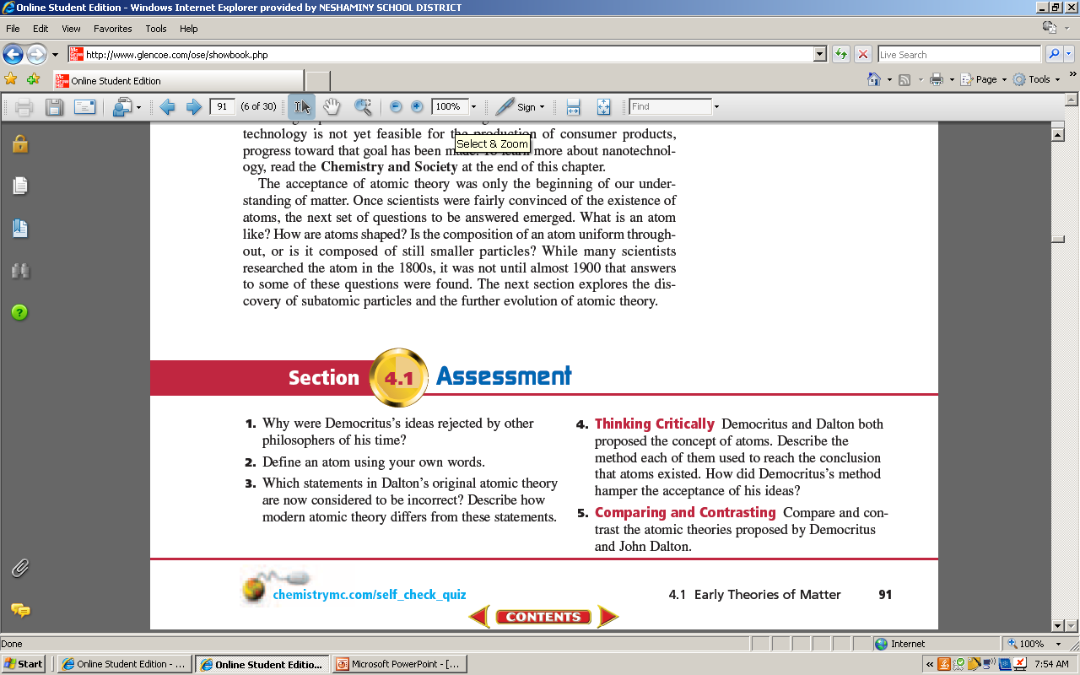
ccc

Slide 19
ccc
Democritus could not explain what held atoms together or verify that atoms moved through empty space.
The smallest component of an element that exhibits all of the characteristic properties of that element.

Slide 20
Dalton was wrong about the atom being indivisible (they are made up of subatomic protons, neutrons and electrons.
All elements of a given element have the same properties- isotopes differ.

Slide 21
Democritus developed his ideas through intellectual thought
Dalton developed his experiments through experimentation and careful measurements.

Slide 23
Both believed that matter is composed of extremely small particles called atoms; all atoms of a given atom are identical but differ from other atoms. Atoms could not be created, destroyed or divided. Democritus believed that matter is composed of empty space through which atoms moved. Dalton said that atoms combine in whole number ratios.

Slide 24
The smallest particle of an element that retains the properties of the element is called an atom.

Slide 25
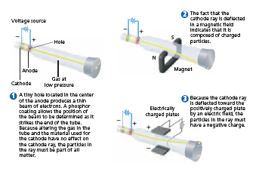
JJ Thomson’s experiments with a cathode ray tube:

Slide 26
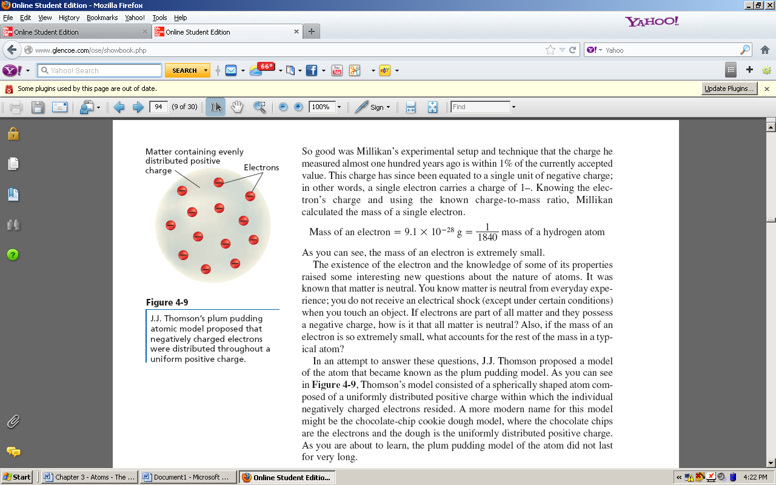
Since matter is neutral, and the mass of an electron was so small compared to the overall mass of the atom, Thompson proposed a model of the atom that became known as the Plum Pudding Model:

Slide 27
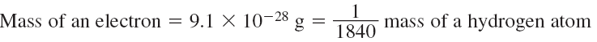
http://www.youtube.com/watch?v=RW_zfKOU9uM

Slide 28
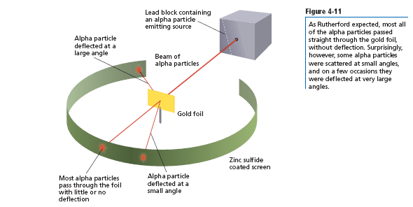
The Nuclear Atom:
Earnest Rutherford gold foil experiment: http://www.youtube.com/watch?v=5pZj0u_XMbc

Slide 29
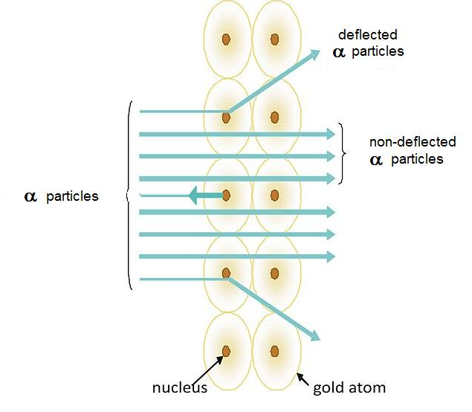
http://www.youtube.com/watch?v=Q8RuO2ekNGw

Slide 30
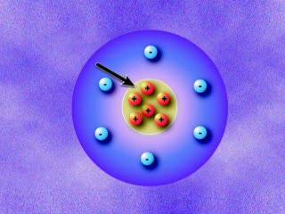
He calculated that the atom was composed of empty space through which the electrons moved.

Slide 31
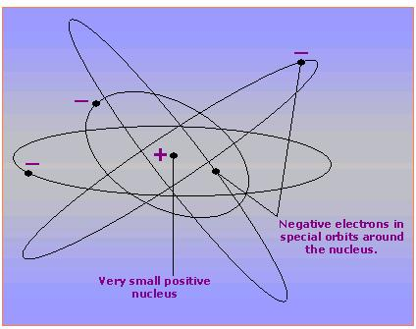
He also concluded that there was a tiny dense region which he called the nucleus, centrally located within the atom that contained all of the atom’s positive charge and virtually all of its mass.

Slide 32
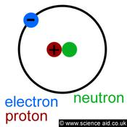
Rutherford concluded that the nucleus consisted of positively charged particles called protons, which have a positive charge that is, equal and opposite to that of an electron. the charge of the proton is 1+ and the charge of an electron is 1-.

Slide 33
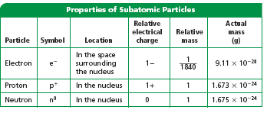
In 1932 English physicist James Chadwick discovered a neutral particle called the neutron. A neutron has nearly the same mass as the proton but has no electrical charge.

Slide 34


Slide 35
The History of the atom
http://www.youtube.com/watch?v=njGz69B_pUg
http://www.youtube.com/watch?v=hhbqIJZ8wCM

Slide 36
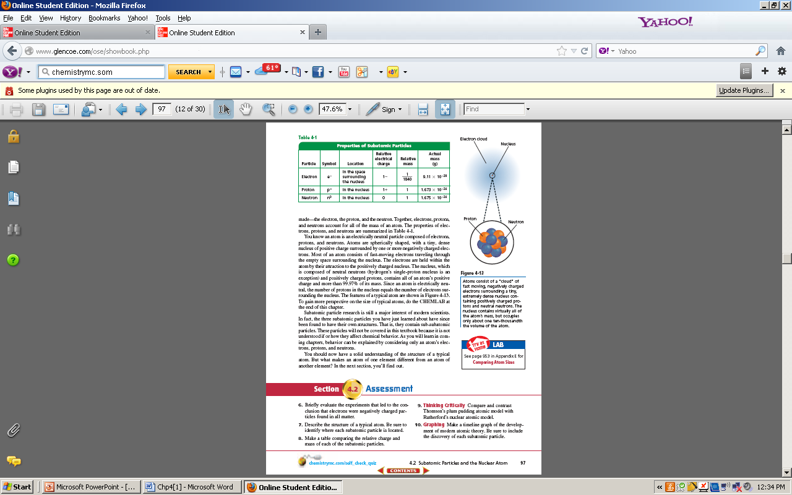
The deflection towards positively charged plates demonstrated the negatively charged nature of electrons.
A typical atom consists of a central, small, dense nucleus containing protons and neutrons, surrounded by a cloud of electrons.

Slide 37
Particle | Relative charge | Relative mass
Electron | -1 | 1/1840
Proton | +1 | 1
Neutron | 0 | 1

Slide 38
Plum pudding- atoms as spherical particles within uniformly distributed positive charge.
Rutherfords model states that an atom is mostly empty space, with a small dense nucleus containing all of the atoms positive charge and most of its mass. The electrons are held in the atom by the attraction to the positively charged nucleus.

Slide 39
Democritus, Aristotle, Crooks, Thompson, Millikan, Rutherford and Chadwick.

Slide 40
4.3 How Atoms Differ
The number of protons in an atom is referred to as the elements atomic number. Since all atoms are neutral, the number of protons is equal to the number of electrons.

Slide 41
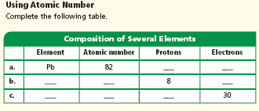

Slide 42
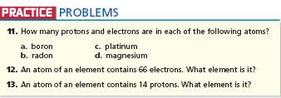

Slide 43
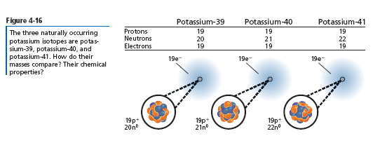
Isotopes and Mass Number
Atoms with the same number of protons, but different number of neutrons are called isotopes.

Slide 44
Isotopes and Mass Number
The mass number is the sum of the protons and neutrons in an atom. the number of neutrons in an isotope can be found by subtracting the atomic number from the mass number.

Slide 45
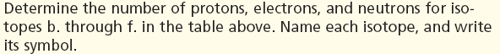
element | Atomic number | Mass number | protons | electrons | neutrons
neon | 10 | 22
calcium | 20 | 46
oxygen | 8 | 17
iron | 26 | 57
zinc | 30 | 64
mercury | 80 | 204

Slide 46
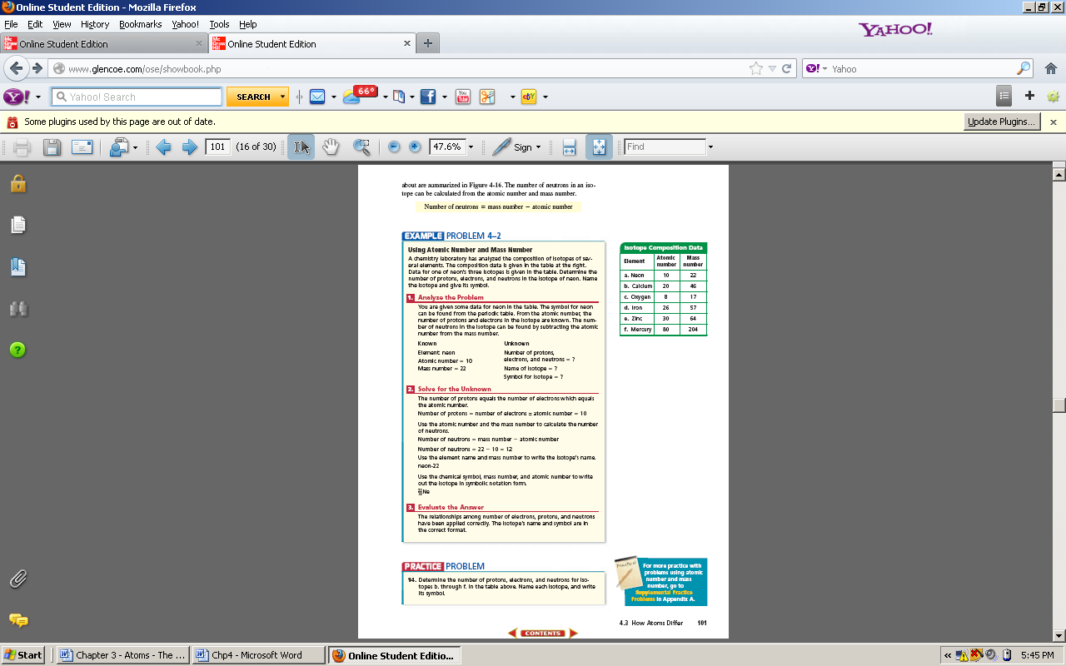

Slide 47
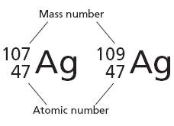

Slide 48
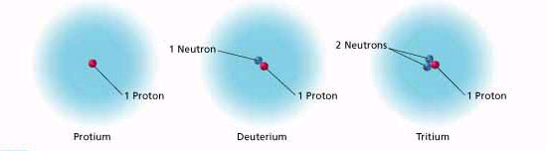
Isotopes of Hydrogen

Slide 49
Atomic number & the number of electrons, protons, and neutrons.
is the general symbol for an isotope where A is the mass number (number of protons + number of neutrons), X is the element’s symbol, and Z is the atomic number (number of protons). This information can also be found on the periodic table. Use this information to fill in the chart for the 1st 20 elements on the periodic table.

Slide 50
Symbol | Atomic Number | Mass Number | Protons | Electrons | Neutrons | Element Name

Slide 51
Mass of Individual Atoms
The atomic mass of an element is the weighted average of the isotopes of that element. The unit of mass for a single atom is the atomic mass unit 1 amu is the approximate mass of a single proton or neutron. It is equal to one twelfth of the carbon-12 isotope of carbon.

Slide 52
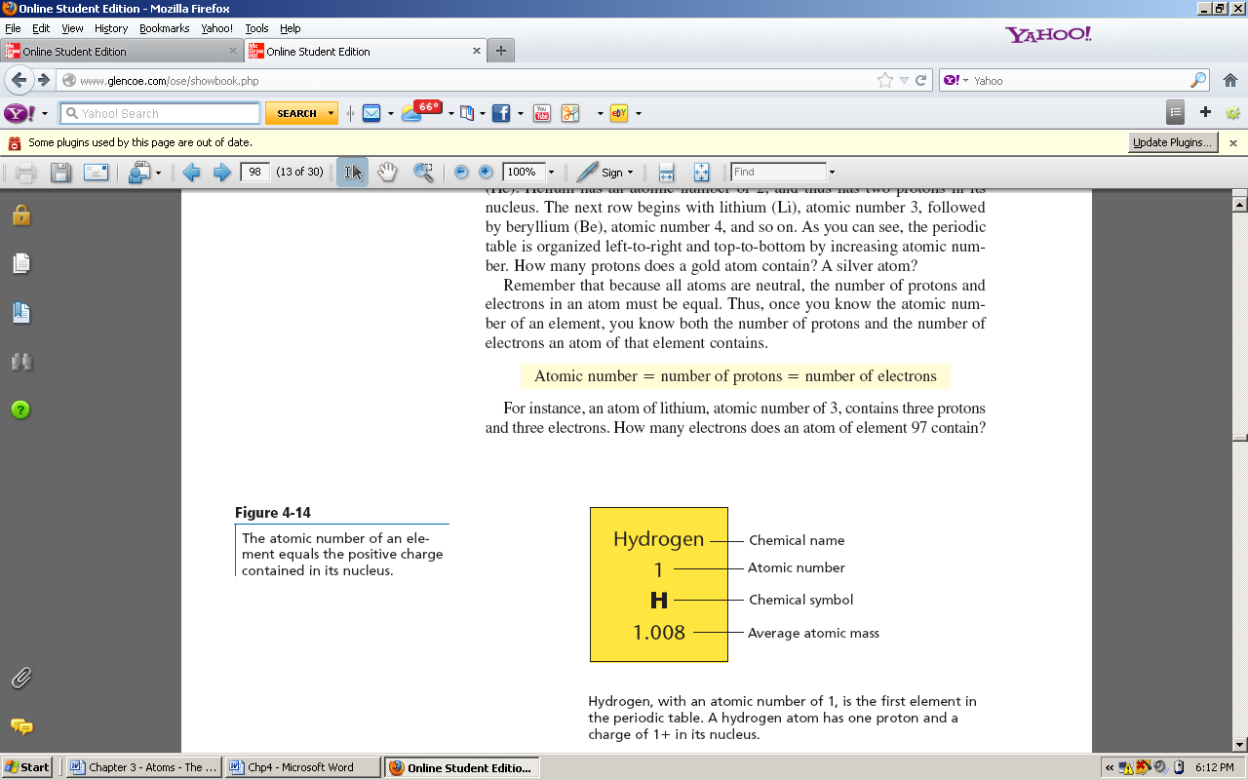

Slide 53
To calculate Average Atomic Mass
Directions:
Write the isotopes.
Write the masses.
Multiply the masses by the decimal equivalent of the relative abundance.
Add the products. This is the average atomic mass.

Slide 54
Example:
A sample of cesium is 20.0 % Cs-132, 75.00 % Cs-133, and 5.0 % Cs-134.
Cs-132 = 132 x 0.200 = 26.4
Cs-133 = 133 x 0.7500 = 99.75
Cs-134 = 134 x 0.050 = _6.7_
132.8
Determine the average atomic mass of the following mixtures of isotopes:
1. 80.0 % I-127, 17.0 % I-126, and 3.00 % I-128.

Slide 55
2. 50.0 % Au-197, 50.0 % Au-198.
3. 15.0 % Fe-55, 85.0 % Fe-56.
4. 99.0 % H-1, 0.800 % H-2, 0.200 % H-3.
5. 95.0 % N-14, 3.00 % N-15, and 2.00 % N-16.
6. 98.0 % C-12, 2.00 % C-14.

Slide 56
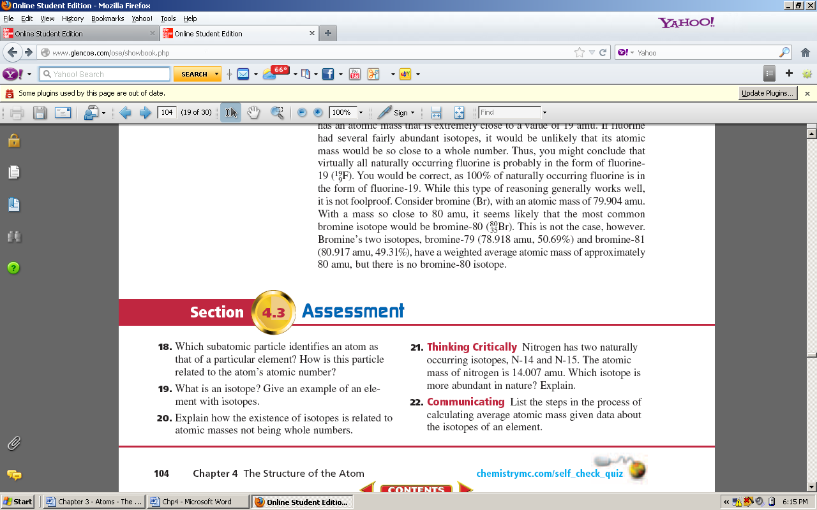

Slide 57
18. The proton. The number of protons equals the atomic number.
19. Isotopes are atoms of the same element that have the same number of protons but different number of neutrons. Carbon has three isotopes: C-12, C-13, and C-14.
20. Atomic masses aren’t whole numbers because they represent weighted averages of the masses of the isotopes of an element.

Slide 58
21. N-14 must be more abundant because the atomic mass of nitrogen, which is a weighted average, is closer to the mass of N-14 than to the mass of N-15.
22. First, multiply the mass of each isotope by it’s percentage abundance; then, sum the mass contributions of all the isotopes.

Slide 59
T
Topics to Study
Philosophers and Scientists
Democretus
Aristotle
Thompson
Cathode Ray experiment
Discovery of the electron
Plum pudding atomic mode

Slide 60
T
Topics to Study
Philosophers and Scientists
Daltons Atomic Theory
Rutherford
Gold foil experiment
Discovery of the positively charged
nucleus - protons
Chadwick – discovery of the neutron

Slide 61
Topics to Study

Slide 62
Topics to Study
Isotope notation
Potassium 39
K-39

Slide 63
Topics to Study
Isotopes of Hydrogen
H-1 H-2 H-3

Slide 64
Topics to Study
Know how to calculate (for atoms and ions)
Protons
Neutrons
Electrons
Atomic mass
Atomic number
mass number

Slide 65
Topics to Study
Know how to calculate average atomic mass for an element.

